Slide 1
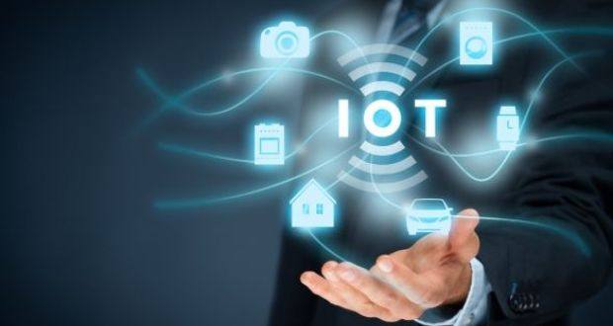
Unit -1 Internet of Things

Slide 2
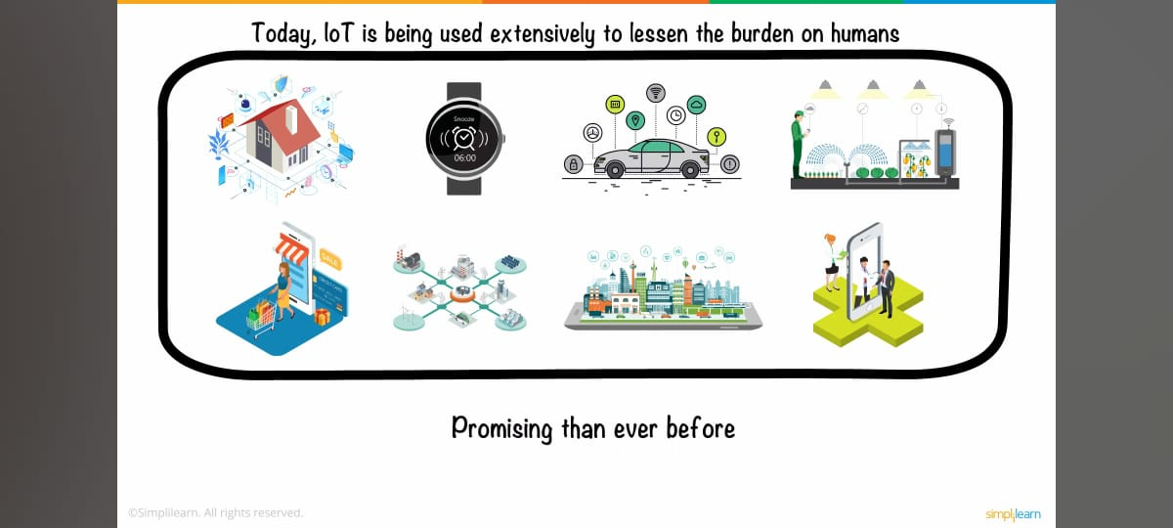
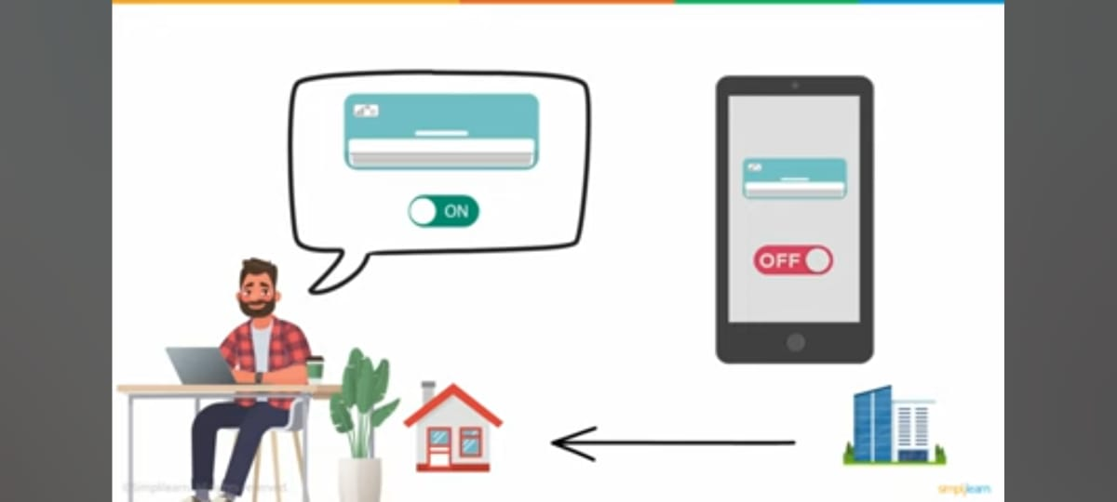
IoT in our daily lives…

Slide 3
Introduction
Imagine a person named joy who has a smart home equipped with IoT devices. Among these devices is a smart air conditioning (A/C) system connected to the internet.
One day, joy leaves for work and forgets to turn off the A/C at home. Instead of worrying about the energy consumption and comfort levels, joy can use a mobile application on his smartphone to remotely control the A/C.
Because The A/C unit at joy 's home is a smart device equipped with IoT capabilities. It is connected to the internet, allowing it to receive and process commands remotely.

Slide 4
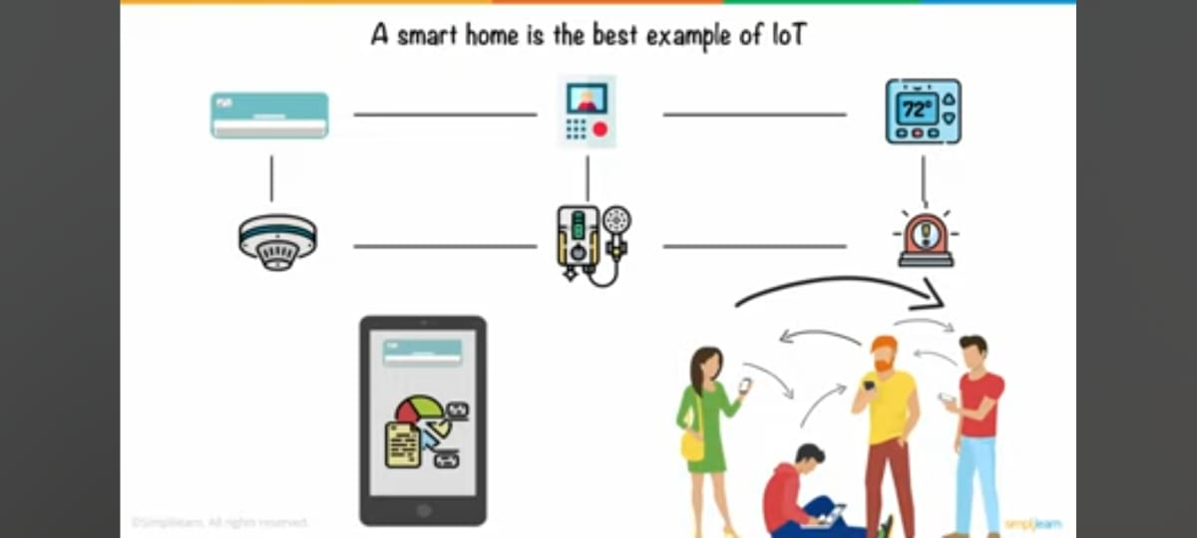

Slide 5
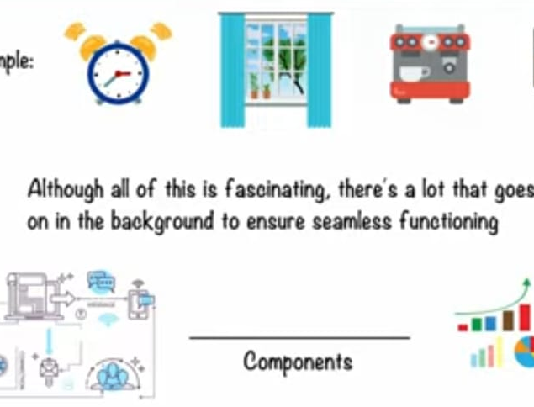
In the Internet of Things (IoT) ecosystem, interrelated devices communicate with each other to collect, exchange, and act upon data. This communication is essential for creating a smart and interconnected environment.

Slide 6
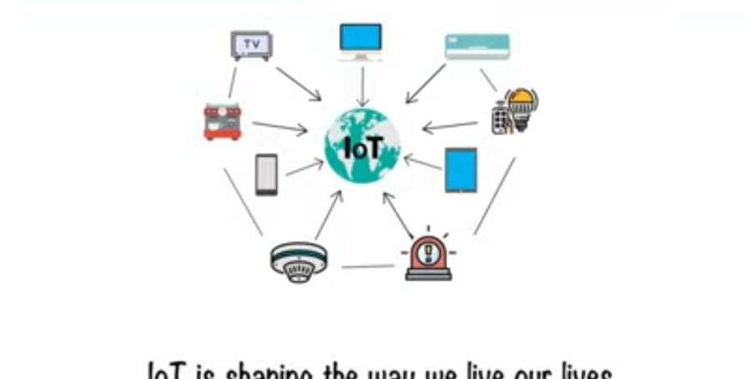

Slide 7
Definition
Internet of Things (IoT) is a concept which enables communication between internetworking devices and applications, whereby physical objects or ‘things’ communication through the Internet.

Slide 8
Definition
IoT means a network of
physical things (objects) sending, receiving, or communicating information using the Internet or other communication technologies and network just as the computers, tablets and mobile and thus, enabling the monitoring, coordinating or controlling process across the Internet or another data network
IoT is the network of physical objects or ‘things’
That embedded with electronics, software, sensors and connectivity to enable it to achieve greater value and service by exchanging data with the manufacturer, operator and/or other connected devices.

Slide 9
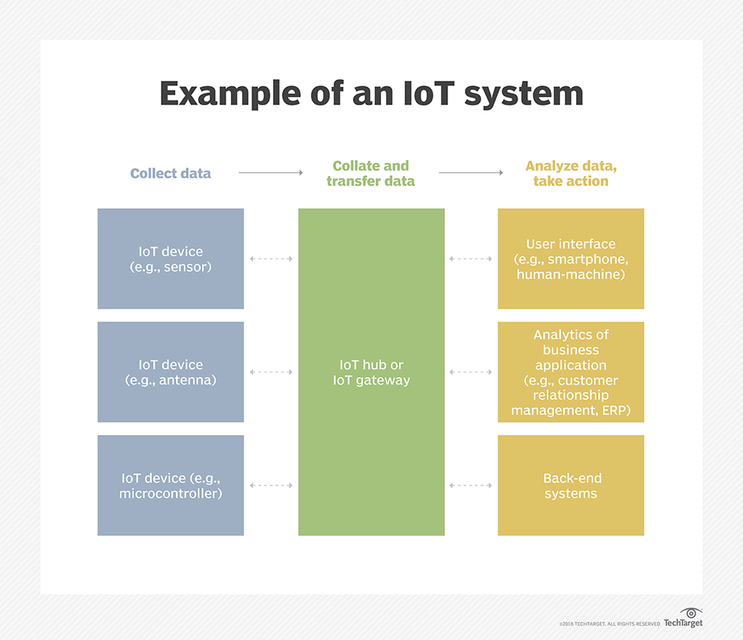

Slide 10
Vision
The concept of IoT enables, for example, GPS- based tracking, controlling and monitoring of devices, machine- to- machine(M2M) communication, connected cars, communication between wearable and personal devices and Industry.
The vision of IoT can be understood through Examples 1.1 and1.2
Example 1.1 : Umbrella
Example 1.2 : Streetlights

Slide 11
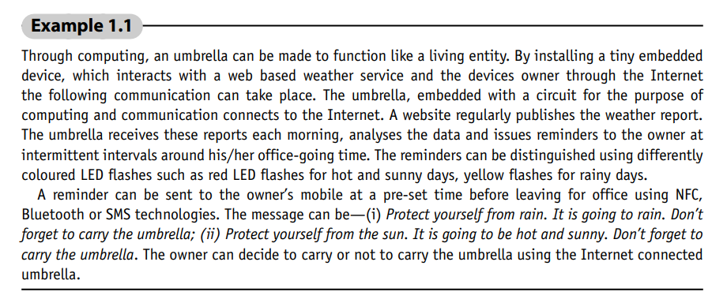
IoT Example 1.1

Slide 12
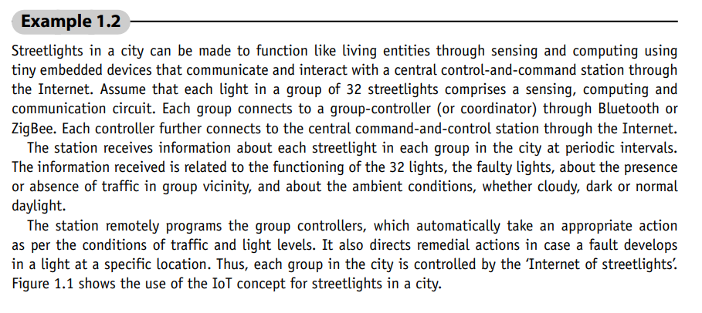
IoT Example 1.2

Slide 13
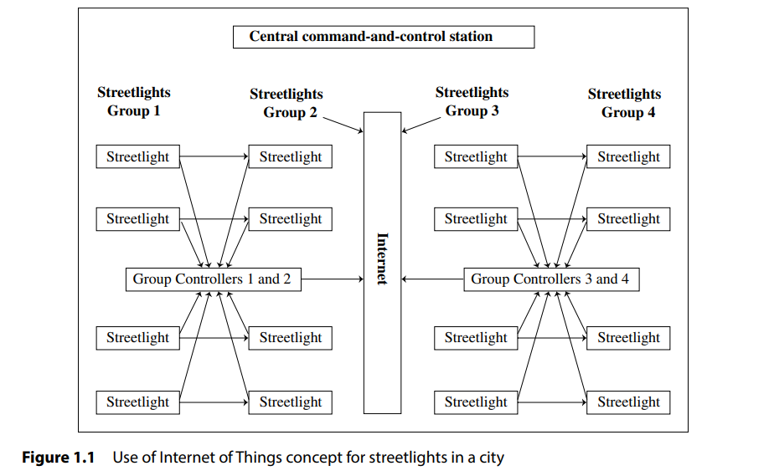

Slide 14
Characteristics Of IoT
1. Connectivity
Connectivity is an important requirement of the IoT infrastructure.
Things of IoT should be connected to the IoT infrastructure.
Anyone, anywhere, anytime can connect, this should be guaranteed at all times.
For example, the connection between people through Internet devices like mobile phones, and other gadgets, also a connection between Internet devices such as routers, gateways, sensors, etc.

Slide 15
2. Intelligence and Identity
The extraction of knowledge from the generated data is very important.
For example, a sensor generates data, but that data will only be useful if it is interpreted properly. Each IoT device has a unique identity. This identification is helpful in tracking the equipment and at times for querying its status.

Slide 16
3. Scalability
The number of elements connected to the IoT zone is increasing day by day. Hence, an IoT setup should be capable of handling the massive expansion. The data generated as an outcome is enormous, and it should be handled appropriately.
4. Dynamic and Self-Adapting (Complexity)
IoT devices should dynamically adapt themselves to changing contexts and scenarios. Assume a camera meant for surveillance. It should be adaptable to work in different conditions and different light situations (morning, afternoon, and night).

Slide 17
5. Safety
Sensitive personal details of users are at risk of being compromised when all their devices are connected to the internet, potentially leading to significant losses. Therefore, ensuring data security is a major challenge. Additionally, the extensive equipment involved poses further risks, and IoT networks may also be vulnerable. As a result, ensuring the safety of equipment is equally critical.

Slide 18
IoT CONCEPTUAL FRAMEWORK
The Internet of Things (IoT) conceptual framework is a structured ecosystem that explains how data moves from sensors to analysis and how the physical and digital worlds are connected. It includes:
Data flow: How data moves from IoT devices and services to the cloud server
Data gathering: Gather and consolidate raw data from a sensor network and gateways
Data communication: Communicate with each other via data streams
Data management: Subsystems for connection, assembly, collection, and management
Data analysis: Subsystems for real-time data analysis, series analysis, and intelligence
Data storage: A data store, database, or cloud infrastructure

Slide 19
IoT CONCEPTUAL FRAMEWORK
Example 1.1 showed a single object (umbrella) communicating with a central server for acquiring data.
The following equation describes a simple conceptual framework of IoT:
…1.1
Physical Object + Controller, Sensor and Actuators + Internet = Internet of Things ….1.1

Slide 20
Physical Object + Controller, Sensor and Actuators + Internet = Internet of Things ….1.1
Equation 1.1 conceptually describes the Internet of umbrellas, a controller, sensor and actuators, and the Internet for connectivity to a web service and a mobile service provider.
Generally, IoT consists of an internetwork of devices and physical objects wherein a number of objects can gather the data at remote locations and communicate to units managing, acquiring, organising and analyzing the data in the processes and services.

Slide 21
Example 1.2 showed the number of streetlights communicating data to the group controller which connects to the central server using the Internet. A general framework consists of the number of devices communicating data to a data centre or an enterprise or a cloud server.
The IoT framework, utilized in numerous applications as well as in enterprise and business processes, is generally more complex than the one represented by Equation 1.1. The following equation conceptually illustrates the actions and data communication occurring at successive levels in IoT, involving interconnected devices and objects.

Slide 22
Gather + Enrich + Stream + Manage + Acquire + Organise and Analyse = Internet of things with connectivity to data centre, enterprise or cloud server ….1.2
Equation 1.2 is an IoT conceptual framework for the enterprise processes and services

Slide 23
Gather + Enrich + Stream + Manage + Acquire + Organize and Analyze = Internet of things with connectivity to data center, enterprise or cloud server ….1.2
Gather: IoT devices collect data using sensors (e.g., temperature, humidity, motion).
Enrich: The raw data is enhanced by adding context or combining it with other information to make it more useful.
Stream: The data is transmitted, often in real time, to a central system or edge devices for processing.
Manage: The system ensures proper control of devices, updates software, and monitors performance.
Acquire: Data is securely stored in a system (e.g., cloud, local servers) for future use.
Organize and Analyze: The stored data is processed and analyzed to generate insights and inform decisions.
Connectivity: IoT systems connect to data centers, enterprise solutions, or cloud servers for advanced processing, remote access, and scalability.

Slide 24
Gather + Enrich + Stream + Manage + Acquire + Organize and Analyze = Internet of things with connectivity to data center, enterprise or cloud server ….1.2
The diagram represents how IoT systems operate as a closed loop of collecting, transmitting, managing, and analyzing data to drive meaningful actions and insights. This interconnected flow ensures seamless communication between devices and centralized systems like the cloud or enterprise platforms, enabling efficient decision-making and automation in various domains like healthcare, manufacturing, transportation, and smart homes.

Slide 25
Gather + Consolidate + Connect + Collect + Assemble + Manage and Analyse= Internet of Things with connectivity and cloud server …1.3
Gather + Consolidate + Connect + Collect + Assemble + Manage and Analyse= Internet of Things with connectivity and cloud server
The equation above is an alternative conceptual representation for a complex system.
It is based on IBM IoT conceptual framework. The equation shows the actions and communication of data at successive levels in IoT. The framework manages the IoT services using data from internetwork of the devices and objects, internet and cloud services, and represents the flow of data from the IoT devices for managing the IoT services using the cloud server.

Slide 26
Gather + Consolidate + Connect + Collect + Assemble + Manage and Analyse= Internet of Things with connectivity and cloud server …1.3
Equation 1.3 represents a complex conceptual framework for IoT using cloud-platform based processes and services. The steps are as follows:
1. Levels 1 and 2 consist of a sensor network to gather and consolidate the data. First level gathers the data of the things (devices) using sensors circuits. The sensor connects to a gateway. Data then consolidates at the second level, for example, transformation at the gateway at level 2.
2. The gateway at level 2 communicates the data streams between levels 2 and 3. The system uses a communication-management subsystem at level 3

Slide 27
Gather + Consolidate + Connect + Collect + Assemble + Manage and Analyse= Internet of Things with connectivity and cloud server …1.3
3. An information service consists of connect, collect, assemble and manage subsystems at levels 3 and 4. The services render from level 4.
4. Real time series analysis, data analytics and intelligence subsystems are also at levels 4 and 5. A cloud infrastructure, a data store or database acquires the data at level 5.

Slide 28
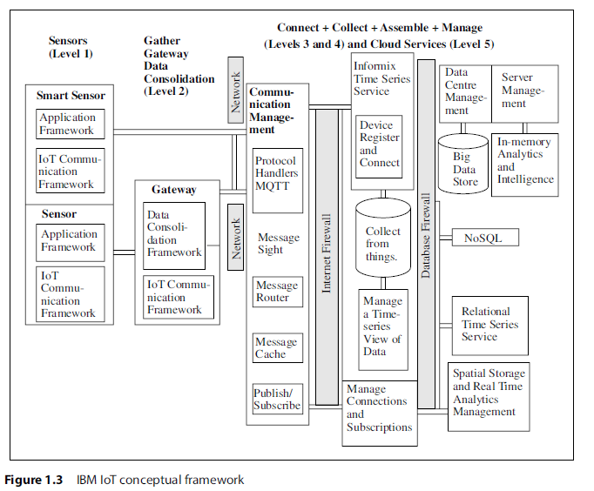
1. Levels 1 and 2 consist of a sensor network to gather and consolidate the data. First level gathers the data of the things (devices) using sensors circuits. The sensor connects to a gateway. Data then consolidates at the second level, for example, transformation at the gateway at level 2.
2. The gateway at level 2 communicates the data streams between levels 2 and 3. The system uses a communication-management subsystem at level 3

Slide 29
3. An information service consists of connect, collect, assemble and manage subsystems at levels 3 and 4. The services render from level 4.
4. Real time series analysis, data analytics and intelligence subsystems are also at levels 4 and 5. A cloud infrastructure, a data store or database acquires the data at level 5.

Slide 30
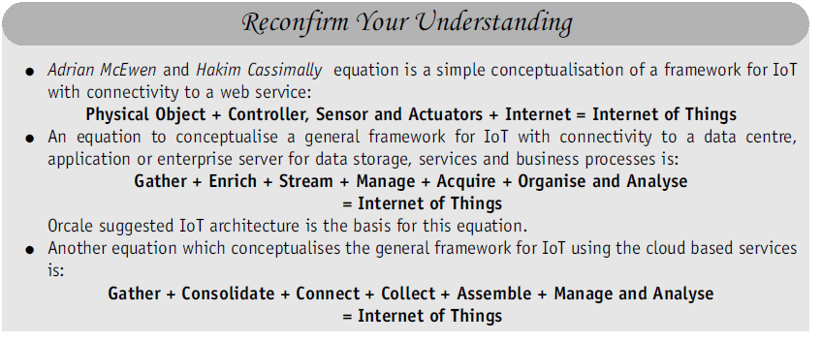

Slide 31
ARCHITECTURAL VIEW OF IOT
Architecture consists of different layers of technologies supporting IoT.
It serves to illustrate how various technologies relate to each other and to communicate the scalability, modularity and configuration of IoT deployments in different scenarios.
An IoT system has multiple levels (Equations 1.1 to 1.3). These levels are also known as tiers. A model enables conceptualisation of a framework. A reference model can be used to depict building blocks, successive interactions and integration.

Slide 32
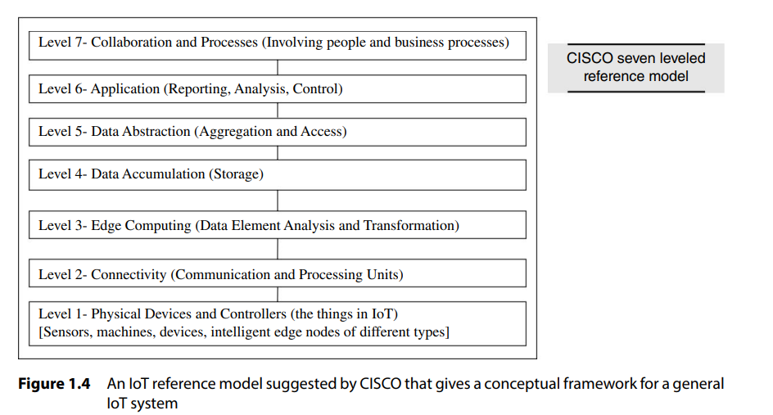
An example is CISCO’s presentation of a reference model comprising seven levels (Figure 1.4)

Slide 33
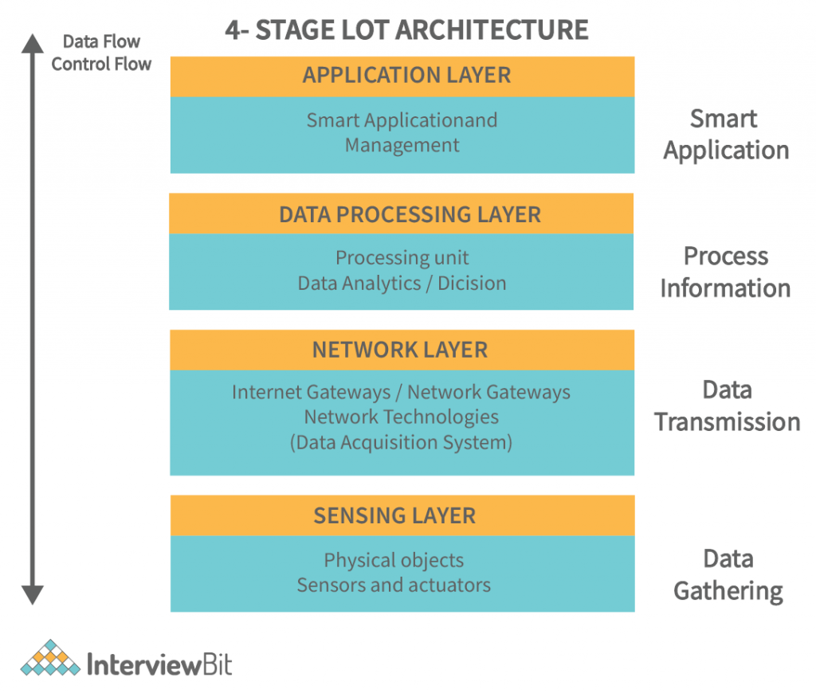

Slide 34
The functionality of each layer is described below:
Smart device / sensor layer:
The lowest layer is made up of smart objects integrated with sensors.
The sensors enable the interconnection of the physical and digital worlds allowing real-time information to be collected and processed. There are various types of sensors for different purposes.
The sensors have the capacity to take measurements such as temperature, air quality, speed, humidity, pressure, flow, movement and electricity etc. In some cases, they may also have a degree of memory, enabling them to record a certain number of measurements.
A sensor can measure the physical property and convert it into signal that can be understood by an instrument. Sensors are grouped according to their unique purpose such as environmental sensors, body sensors, home appliance sensors and vehicle telemetric sensors, etc.

Slide 35
Gateways and Networks
Massive volume of data will be produced by these tiny sensors and this requires a robust and high performance wired or wireless network infrastructure as a transport medium.
Current networks, often tied with very different protocols, have been used to support machine-to-machine (M2M) networks and their applications.
With demand needed to serve a wider range of IoT services and applications such as high speed transactional services, context- aware applications, etc, multiple networks with various technologies and access protocols are needed to work with each other in a heterogeneous configuration.
These networks can be in the form of a private, public or hybrid models and are built to support the communication requirements for latency, bandwidth or security. Various gateways (microcontroller, microprocessor) & gateway networks (WI-FI (Wireless Fidelity), GSM (Global System for Mobile Communication), GPRS (General Packet Radio Service)).

Slide 36
Management Service Layer/ Data Processing Layer
Data Aggregation and Processing: Collects, filters, and processes data from IoT devices to derive actionable insights.
Analytics and Decision Support: Applies analytics and AI techniques to enable real-time and batch decision-making.
Service Management: Manages IoT devices, including monitoring, updates, and provisioning, ensuring smooth operations.
Security and Privacy: Ensures secure data handling with encryption, access control, and compliance with privacy regulations.

Slide 37
Management Service Layer/ Data Processing Layer
The data processing layer of IoT architecture refers to the software and hardware components that are responsible for collecting, analyzing, and interpreting data from IoT devices.
This layer is responsible for receiving raw data from the devices, processing it, and making it available for further analysis or action.
The data processing layer includes a variety of technologies and tools, such as data management systems, analytics platforms, and machine learning algorithms.
These tools are used to extract meaningful insights from the data and make decisions based on that data.

Slide 38
Application Layer
The application layer of IoT architecture is the topmost layer that interacts directly with the end-user.
It is responsible for providing user-friendly interfaces and functionalities that enable users to access and control IoT devices.
This layer includes various software and applications such as mobile apps, web portals, and other user interfaces that are designed to interact with the underlying IoT infrastructure.
The IoT application covers “smart” environments/spaces in domains such as: Transportation, Building, City, Lifestyle, Retail, Agriculture, Factory, Supply chain, Emergency, Healthcare, User interaction, Culture and tourism, Environment and Energy.

Slide 39
TECHNOLOGY BEHIND IoT
Hardware (Arduino Raspberry Pi, Intel Galileo, Intel Edison, ARM mBed, Bosch XDK110, Beagle Bone Black and Wireless SoC)
Integrated Development Environment (IDE) for developing device software, firmware and APIs
Protocols [RPL, CoAP, RESTful HTTP, MQTT, XMPP (Extensible Messaging and Presence Protocol)]
Communication (Powerline Ethernet, RFID, NFC, 6LowPAN, UWB, ZigBee, Bluetooth, WiFi, WiMax, 2G/3G/4G)
Network backbone (IPv4, IPv6, UDP and 6LowPAN)
Software (RIOT OS, Contiki OS, Thingsquare Mist firmware, Eclipse IoT)
Internetwork Cloud Platforms/Data Centre (Sense, ThingWorx, Nimbits, Xively, openHAB, AWS IoT, IBM BlueMix, CISCO IoT, IOx and Fog, EvryThng, Azure, TCS CUP)
https://youtu.be/5NfKeofbac4

Slide 40
1.4.1 Server-end Technology
IoT servers are application servers, enterprise servers, cloud servers, data centres and databases.
Servers offer the following software components:
Online platforms
Devices identification, identity management and their access management
Data accruing (process of collecting, transmitting, and managing data generated by IoT devices and sensors within a network), aggregation, integration, organising and analysing
Use of web applications, services and business processes

Slide 41
1.4.2 Major Components of IoT System
Physical object
with embedded software into a hardware
Hardware
consisting of a microcontroller, firmware, sensors, control unit, actuators and communication module.
Communication module
Software consisting of device APIs and device interface for communication over the network and communication circuit/port(s), and middleware for creating communication stacks using 6LowPAN, CoAP, LWM2M, IPv4, IPv6 and other protocols.
Software
for actions on messages, information and commands which the devices receive and then output to the actuators, which enable actions such as glowing LEDs, robotic hand movement etc.

Slide 42
Sensors and Control Units
Sensors:
Sensors are electronic devices that sense the physical environments.
An industrial automation system or robotic system has multiple smart sensors embedded in it. Sensor-actuator pairs are used in control systems. A smart sensor includes computing and communication circuits.
Sensors are of two types.
1. The first type gives analog inputs to the control unit.
Examples are thermistor, photoconductor, pressure gauge and Hall sensor.
2. The second type gives digital inputs to the control unit.
Examples are touch sensor, proximity sensor, metal sensor, traffic presence sensor, rotator encoder for measuring angles and linear encoders for measuring linear displacements.
Analog input is a continuous input from the field

Slide 43
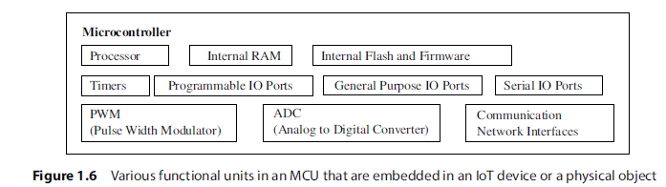
Control Units
Most commonly used control unit in IoT consists of a Microcontroller Unit (MCU) or a custom chip.
A microcontroller is an integrated chip or core in a VLSI (Very Large Scale Integration) or SoC (Security Operations Center).
Popular microcontrollers are ATmega 328, ATMega 32u4, ARM Cortex and ARM LPC (Advanced RISC Machine, Low Pin Count) .

Slide 44
Communication Module
Temporarily stores frequently accessed or recently processed messages to speed up access and reduce redundant processing..
This is a data structure or mechanism used to temporarily store and manage messages (data units) for orderly processing.
A communication module consists of protocol handlers, message queue and message cache.

Slide 45
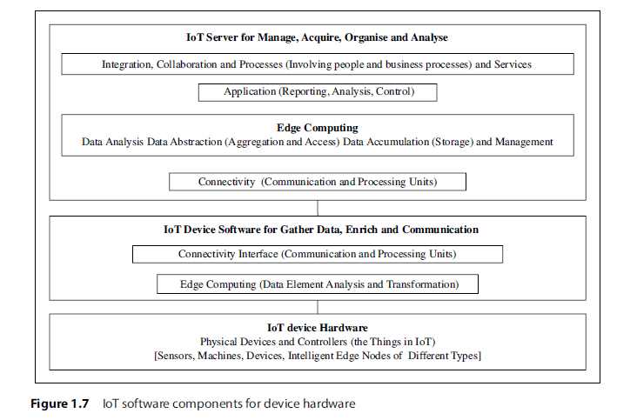
Software
IoT software consists of two components—software at the IoT device and software at the IoT server.
Figure 1.7 shows the software components for the IoT device hardware and server.

Slide 47
Middleware
OpenIoT is an open-source middleware platform designed to enable the integration, management, and utilization of Internet of Things (IoT) devices and services.
The oBIX is standard XML and web services protocol oBIX (Open Building Information Xchange).
It provides a framework for connecting IoT devices, collecting sensor data, and delivering it to applications or users through cloud-based solutions.
IoTSyS is middleware that helps smart devices communicate by supporting various standards and protocols, including IPv6, oBIX, 6LoWPAN, and CoAP. It simplifies connecting and managing smart devices by providing a unified communication system.

Slide 48
Operating Systems (OS)
Examples of OSs are RIOT, Raspbian, AllJoyn, Spark and Contiki.
RIOT is an operating system for IoT devices.
Raspbian is a popular Raspberry Pi operating system
AllJoyn is an open-source OS created by Qualcomm.
Spark is a distributed, cloud-based IoT operating system and web-based IDE.
Contiki OS7 is an open-source multitasking OS.

Slide 49
Firmware
Thingsquare Mist is an open-source firmware (software embedded in hardware) for true Internet-connectivity to the IoT.
It enables resilient wireless mesh networking.
Several microcontrollers with a range of wireless radios support Things MIST.
Firmware is a form of microcode or program embedded into hardware devices to help them operate effectively. Hardware like cameras, mobile phones, network cards, optical drives, printers, routers, scanners, and television remotes rely on firmware built into their memory to function smoothly.

Slide 50
Let us categorise the resources which enable the development of IoT prototype and product

Slide 51
SOURCES OF IoT
Examples of hardware sources for IoT prototype development are:
Arduino Yún (ATmega32U4 microcontroller)
Microduino
Beagle Board
RasWIK, etc.
Hardware prototype needs an IDE(integrated Development Environment) for developing device software, firmware and APIs.

Slide 52
Popular IoT Development Boards
Arduino Yún
Microduino
Intel Galileo
Intel Edison
Beagle Board
Raspberry Pi Wireless Inventors Kit (RasWIK)

Slide 53
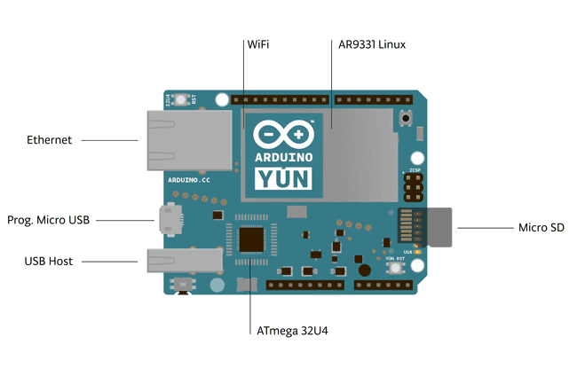
1. Arduino Yún
Arduino Yún board uses microcontroller ATmega32u4 that supports Arduino and includes Wi-Fi, Ethernet, USB port, micro-SD card slot and three reset buttons. The board also combines with Atheros AR9331 that runs Linux.

Slide 54
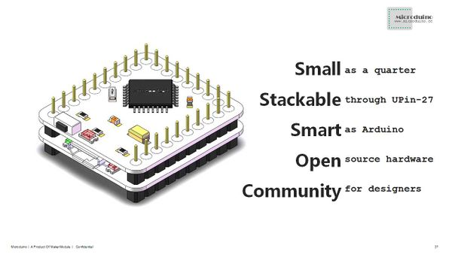
2. Microduino
Microduino is a small board compatible with Arduino that can be stacked with the other boards.
All the hardware designs are open source.

Slide 55
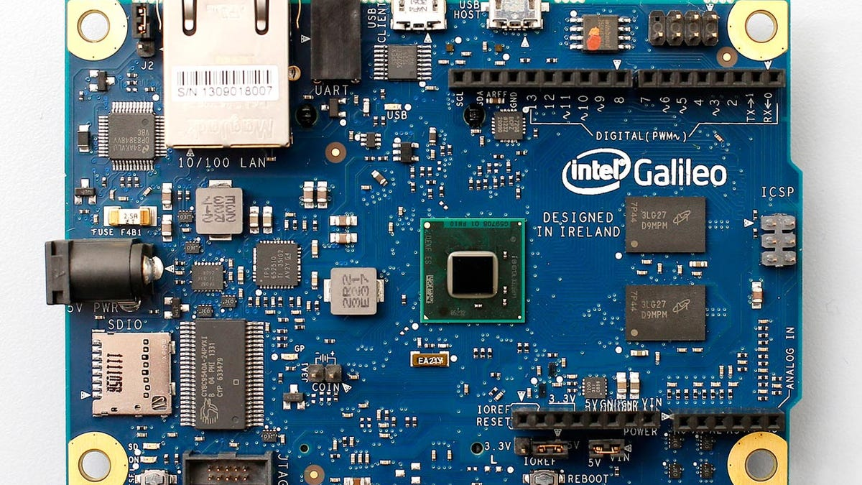
3. Intel Galileo
Intel Galileo is a line of Arduino-certified development boards. Galileo is based on Intel x86 architecture. It is open-source hardware that features the Intel SOC X1000 Quark based Soc.
Galileo is pin-compatible with Arduino. It has 20 digital I/O (12 GPIOs fully native), 12-bit PWM for more precise control, six analog inputs and supports power over Ethernet (PoE)

Slide 56
Intel Galileo

Slide 57
4. Intel Edison
Intel Edison19 is a compute module.
It enables creation of prototypes and fast development of prototyping projects and rapidly produces IoT and wearable computing devices.
It enables seamless device internetworking and device-to-cloud communication.
It includes foundational tools. The tools collect, store and process data in the cloud, and process rules on the data stream.
It generates triggers and alerts based on advanced analytics.

Slide 58
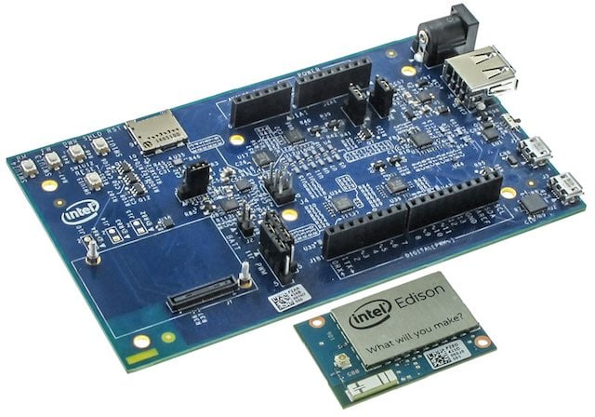
4. Intel Edison

Slide 59
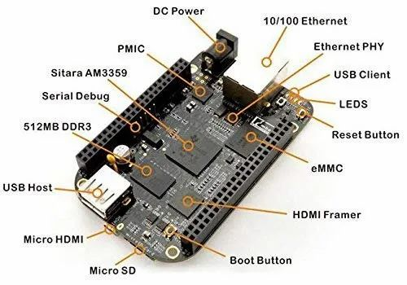
5. Beagle Board
Beagle Bone based board has very low power requirement.
It is a card-like computer which can run Android and Linux.
Both the hardware designs and the software for the IoT devices are open source.

Slide 60
6. Raspberry Pi Wireless Inventors Kit (RasWIK)
RasWIK enables Raspberry Pi Wi-Fi connected devices.
It includes documentation for 29 different projects or you can come up with one of your own.
There is a fee for the devices but all of the included code is open source, and you can use it to build commercial products as well.

Slide 61
1.5.2 Role of RFID and IoT Applications
Earlier IoT systems were internet-connected RFID based systems.
RFID enables tracking and inventory control, identification in supply chain systems, access to buildings and road tolls or secured store centre entries, and devices such as RFID-based temperature sensors.
RFID networks have new applications in factory design, 3PL-management, brand protection, and anti-counterfeiting in new business processes for payment, leasing, insurance and quality management.

Slide 62
1.5.3 Wireless Sensor Networks (WSNs)
Sensors can be networked using wireless technology and can cooperatively monitor physical or environmental conditions.
Sensors acquire data from remote locations, which may not be easily accessible.
Each wireless sensor also has communication abilities for which it uses a radio-frequency transceiver.
Each node either has an analog sensor with signal conditioner circuit or a digital sensor.
Sensing can be done to monitor temperature, light intensity, presence of darkness, metal proximity, traffic, physical, chemical and biological data etc.

Slide 63
Wireless Sensor Network (WSN)
Wireless Sensor Network (WSN) is defined as a network in which each sensor node connects wirelessly and has capabilities of computations for data compaction, aggregation and analysis plus communication and networking. WSN node is autonomous.
Autonomous refers to independent computing power and capability to send requests and receive responses, and data forward and routing capabilities.

Slide 64
WSN Node
A WSN node has limited computing power. It may change topology rapidly.
The WSN network in the topology-changing environment functions as an ad-hoc network.
A WSN network in that environment is generally self-configuring, self-organising, self-healing and self-discovering.

Slide 65
1.6 M2M COMMUNICATION
Machine-to-machine (M2M) refers to the process of communication of a physical object or device at machine with others of the same type, mostly for monitoring but also for control purposes. Each machine in an M2M system embeds a smart device.
The device senses the data or status of the machine, and performs the computation and communication functions M2M technology involves the automatic and streamlined sharing of information between two or more separate devices.
Common examples include smart home meters, vehicle telemetry services, asset tracking, wearable technologies, and automated supply chain management (SCM).

Slide 66
Difference between IoT and M2M
Basis of | IoT | M2M
Abbreviation | Internet of Things | Machine to Machine
Intelligence | Devices have objects that are responsible for decision making | Some degree of intelligence is observed in this.
Connection type used | The connection is via Network and using various communication types. | The connection is a point to point
Communication protocol used | Internet protocols are used such as HTTP, FTP, and Telnet. | Traditional protocols and communication technology techniques are used
Data Sharing | Data is shared between other applications that are used to improve the end-user experience. | Data is shared with only the communicating parties.
Internet | Internet connection is required for communication | Devices are not dependent on the Internet.
Type of Communication | It supports cloud communication | It supports point-to-point communication.
Components | Devices/sensors, connectivity, data processing, user interface | Device, area networks, gateway, Application server.
Examples | Smart wearables, Big Data and Cloud, etc. | Sensors, Data and Information, etc.

Slide 67
Difference between IoT and M2M
Basis of | IoT | M2M
Computer System | Involves the usage of both Hardware and Software. | Mostly hardware-based technology
Scope | A large number of devices yet scope is large. | Limited Scope for devices.
Business Type used | Business 2 Business(B2B) and Business 2 Consumer(B2C) | Business 2 Business (B2B)
Open API support | Supports Open API integrations. | There is no support for Open APIs
It requires | Generic commodity devices. | Specialized device solutions.
Centric | Information and service centric | Communication and device centric.
Approach used | Horizontal enabler approach | Vertical system solution approach .

Slide 68
Features of M2M Communication
Efficient Energy Use for Enhanced M2M: The M2M system conserves energy, leading to improved performance in M2M applications.
Seamless Data Exchange in M2M: Network operators utilize organized data packets to ensure smooth information sharing among machines in M2M communication.
Rapid Event Detection: Through monitoring, the system swiftly identifies events.
Flexible Data Timing: Data transfers can tolerate minor delays.
Scheduled Information Sharing: Data is transmitted or received at specific, pre-defined times.
Location-Based Device Notifications: Devices receive alerts when entering specific areas.
Steady and Small-Scale Data Transfer: The system maintains a consistent flow of small data packets.

Slide 69
1.6.1 M2M to IoT
IoT technology in industry involves the integration of complex physical machinery M2M communication with the networks of sensors, and uses analytics, machine learning, and knowledge discovery software.
M2M technology closely relates to IoT when the smart devices or machines collect data which is transmitted via the Internet to other devices or machines located remotely.
The close difference between M2M and IoT is that M2M must deploy device to device, and carry out the coordination, monitoring, controlling of the devices and communicate without the usage of Internet whereas IoT deploys the internet, server, internet protocols and server or cloud end applications, services or processes.

Slide 70
1.6.2 M2M Architecture
M2M architecture consists of three domains (Figure 1.9):
M2M device domain - consists of three entities: physical devices, communication interface and gateway. Communication interface is a port or a subsystem, which receives the input from one end and sends the data received to another.
M2M network domain - consists of M2M server, device identity management, data analytics and device management similar to IoT architecture (connect + collect +assemble + analyse) level.
M2M application domain - consists of application for services, monitoring, analysis and controlling of devices networks.

Slide 71
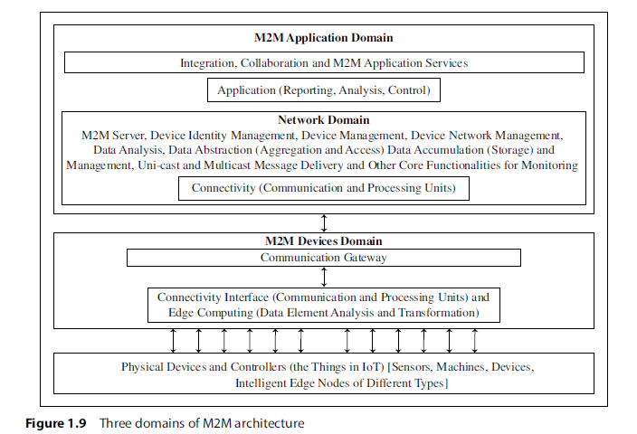

Slide 72
Summary
M2M refers to communication of devices (machines) with others of same type mostly for monitoring and control purposes.
M2M technology closely relates to IoT.
Close differences exist in M2M and IoT. M2M uses device-to-device communication for coordinated monitoring plus control purposes but IoT uses the Internet and server or cloud end protocols and applications.
M2M device communication domain consists of three entities: physical devices, communication interface and gateway.
M2M network domain consists of M2M server, device identity management, data analytics, data management and device management similar to IoT architecture (Connect + Collect + Assemble + Analyse) level.
M2M application domain consists of application for services, monitoring, analysis and control of the devices networks.
Open protocols, tools and frameworks are available for M2M.

Slide 73
1.7 EXAMPLES OF IoT
1.7.1 Wearable Smart Watch
1.7.2 Smart Home
1.7.3 Smart Cities
[Reference: Raj Kamal “INTERNET OF THINGS”, McGraw-Hill, 1ST Edition, 2016]

Slide 74
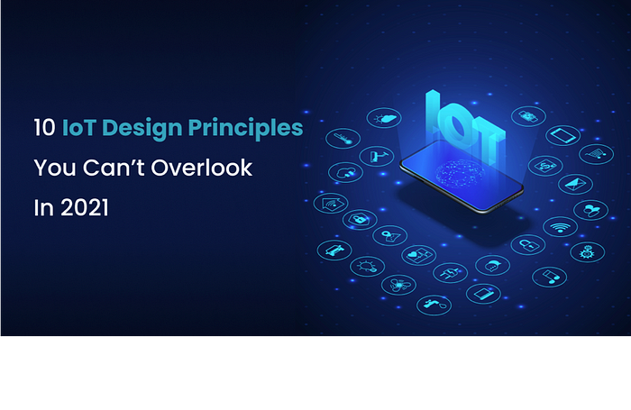
Design Principles for Connected Devices Unit 1 Chapter 2

Slide 75
Introduction
When a letter is written then it is written according to a protocol (etiquette).
To send a letter, it is first put in an envelope, and then the envelope is marked with the receiver’s address at the centre, sender’s address at left hand bottom area, stamp(s) is/are affixed at right hand top corner and the type of post is mentioned on top line in the centre.
All letters are then gathered (stacked) and the stack is sent to the target city.
Each action takes place according to a specified protocol at each stage (layer).
Similarly, when data is transferred from a sensor, then functional units create a stack for data communication to an application or service.

Slide 76
What is Data?
IoT or M2M device data refers to the data meant for communication to an application, service or process.
Data also refers to data received by a device for its monitoring or for actions at actuator in it.
Data stack: denotes the data received after the actions at various in-between layers (or levels or domains).
Layers in Open Systems Interconnection (OSI) model are Application, Presentation, Session, Transport, Network, Data-link and Physical.

Slide 77
Key terms to know..
Following are the key terms which need to be understood to learn the design principles of connected devices for IoTs:
Layer
Physical Layer
Application Layer
Level
Domain
Gateway
IP
Header
Packet
Protocol Data Unit (PDU)
Maximum Transmission Unit (MTU)
Star network
Mesh network End-point device or node
Coordinator
Master
Slave
Router
ISM band
Service
Process

Slide 78
2.2 IoT/M2M SYSTEMS, LAYERS AND DESIGNS STANDARDISATION
A number of international organizations have taken action for IoT design standardization. Following are the examples:
Internet Engineering Task Force (IETF)
International Telecommunication Union for Telecommunication (ITU-T)
European Telecommunication Standards Institute (ETSI)
Open Geospatial Consortium (OGC)

Slide 79
2.2.1 Modified OSI Model for the IoT/M2M Systems
OSI protocols mean a family of information exchange standards developed jointly by the ISO and the ITU-T.
The seven-layer OSI model is a standard model.
It gives the basic outline for designing a communication network.
Various models for data interchanges consider the layers specified by the OSI model, and modify it for simplicity according to the requirement.
Similarly, IETF suggests modifications in the OSI model for the IoT/M2M.

Slide 80
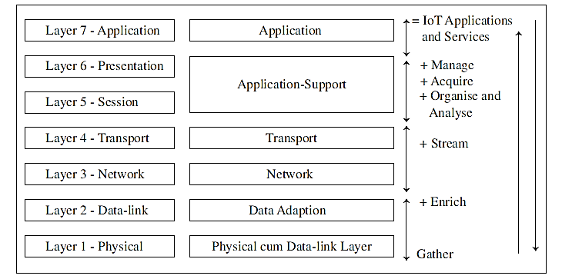
Figure 2.1 shows a classical seven-layer OSI model (on the left) and the modifications in that model proposed by IETF (in the middle).
and Data Link Layer

Slide 81
Figure 2.1 shows a classical seven-layer OSI model (on the left) and the modifications in that model proposed by IETF (in the middle).
Data communicates from device end to application end.
Each layer processes the received data and creates a new data stack which transfers it to the next layer.
The processing takes place at the in-between layers, i.e. between the bottom functional-layer to the top layer.
Device end also receives data from an application/service after processing at the in-between layers.
Figure 2.1 also shows a similarity with the conceptual framework in Equation 1.2:
Gather + Enrich + Stream + (Manage + Acquire + Organise and Analyse) = IoT Applications and Services

Slide 82
Case study
What are the architectural layers in a modified OSI model for Internet of smart streetlights application in the model for Internet of streetlights(Example 1.1)

Slide 83
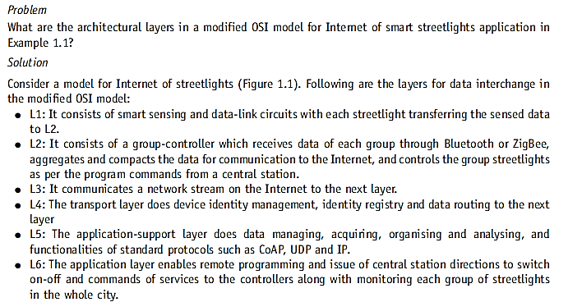

Slide 84
2.2.2 ITU-T Reference Model
Figure 2.2 shows the ITU-T reference model RM1. It also shows correspondence of the model with the six-layers modified OSI model (Figure 2.1). The figure also shows a comparison with CISCO IoT reference model RM2 (Figure 1.4). RM1 considers four layers which are:
Lowest layer, L1, is the device layer and has device and gateway capabilities.
Next layer, L2, has transport and network capabilities.
The next layer, L3, is the services and application-support layer. It provides two types of support:
Generic capabilities: Common functions used by multiple applications.
Specific capabilities: Support tailored for particular services or applications.
Top layer, L4, is for applications and services.

Slide 85
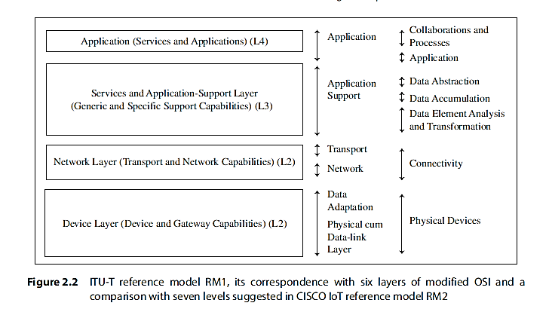

Slide 86
ITU-T four layers
ITU-T recommends four layers, each with different capabilities. A comparison of ITU-T RM1 with the six-layer OSI model can be made as follows:
RM1 device layer capabilities are similar to data-adaptation and physical and datalink layers.
RM1 network layer capabilities are similar to transport and network layers.
RM1 upper two layer capabilities are similar to top two layers.

Slide 87
Comparison between RM1 and RM2
A comparison of ITU-T RM1 with the CISCO IoT reference model (RM2) can be made as follows:
RM1 L4 capabilities are similar to RM2 collaborations and processes, and application top two levels.
RM1 L3 capabilities are similar to RM2 three middle-level functions of data abstraction accumulation, analysis and transformation.
RM1 L2 layer capabilities are similar to RM2 functions at connectivity level.
RM1 L1 device layer capabilities are similar to RM2 functions at physical devices level.

Slide 88
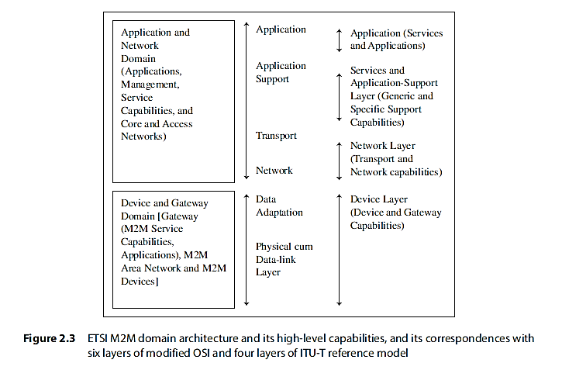
2.2.3 ETSI M2M Domains and High-level Capabilities

Slide 89
Case Study : What are domains and their service capabilities in ETSI high-level architecture for applications and services in Internet of ATM machines?
Solution
ETSI high-level architecture for applications and services in Internet of ATM machines has two domains:
Device and gateway domain:
Device refer to cards and ATMs, while ATM service capabilities and ATM applications are present at the ATM gateway. The gateway has system for acquiring the card as well as banking data. Data interchange between an ATM machine and the bank server takes place through the gateway.
The domain has cash dispensing and surveillance systems.
All the ATM systems network through an access network. The gateway communicates the data after enriching and transcoding according to the network protocol between an AP and data for the machine.
A domain subsystem monitors cash dispensing and other services.
Applications and network domain:
Application and network domain has two functional units—ATM management functions and network management functions. It has banking applications and service capabilities for the ATMs.
It communicates with the bank CoRE network which connects all the access networks of ATM gateways.

Slide 90
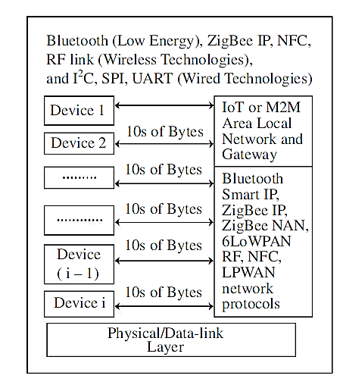
2.3 COMMUNICATION TECHNOLOGIES
Physical and data-link layer in the model consists of a LAN/PAN.
A local network of IoT or M2M device deploys one of the two types of technologies - wireless or wired communication technologies.
Figure 2.4 Connected devices 1st to ith connected to the local network and gateway using the WPAN or LPWAN network protocols

Slide 91
2.3.1 Wireless Communication Technology
Near-Field Communication
Bluetooth BR/EDR and Bluetooth Low Energy
ZigBee IP/ZigBee SE 2.0
Wi-Fi
RF Transceivers and RF Modules
GPRS/GSM (General Packet Radio Service and Global System for Mobile) Cellular Networks-Mobile Internet
Wireless USB
2.3.2 Wired Communication Technology
UART/USART (Universal Asynchronous Receiver Transmitter/Universal Synchronous/Asynchronous Receiver Transmitter.) Serial Communication
Serial Peripheral Interface
I2C Bus
Wired USB
Ethernet

Slide 92
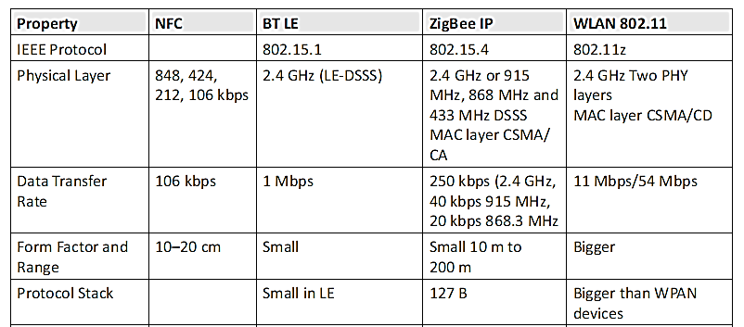
2.3.3 Communication Technologies— A Comparison

Slide 93
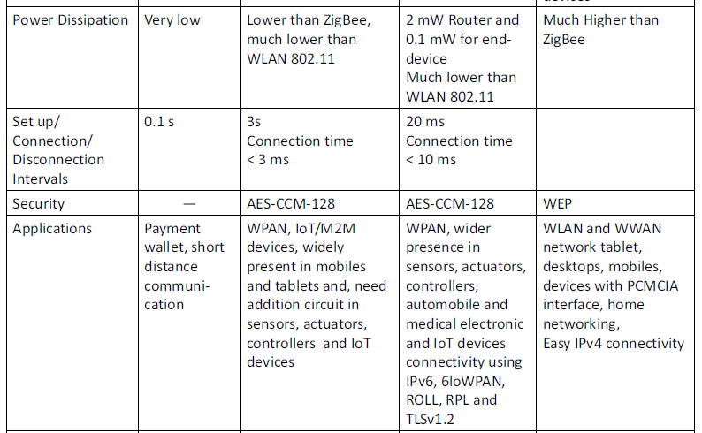

Slide 94
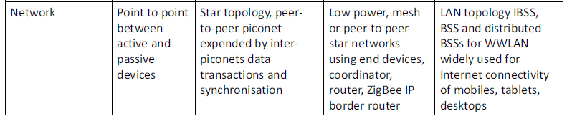
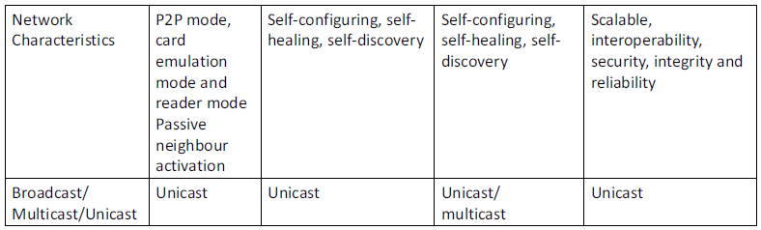

Slide 95
2.4 DATA ENRICHMENT, DATA CONSOLIDATION AND DEVICE MANAGEMENT AT GATEWAY
A gateway at a data-adaptation layer has several functions.
These are data privacy, data security, data enrichment, data consolidation, transformation and device management.
A gateway consists of the data enrichment, consolidation and IoT communication frameworks.
The communication gateway enables the devices to communicate and network with the web.
The communication gateway uses message transport protocols and web communication protocols for the Internet.
The gateway includes two functions: data management and consolidation, and connected device management.

Slide 96
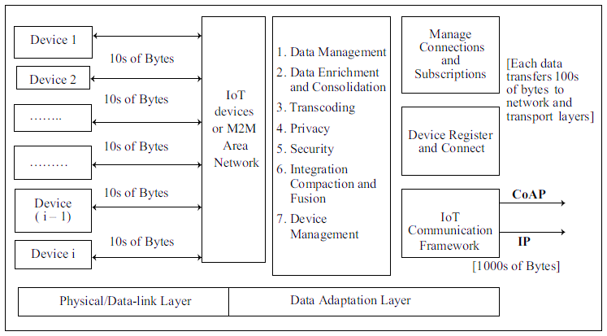
Figure 2.7 IoT or M2M gateway consisting of data enrichment and consolidation, device management and communication frameworks at the adaptation layer

Slide 97
2.4.1 Data Management and Consolidation Gateway
Gateway includes the provisions for one or more of the following functions: transcoding (Transcoding refers to the conversion of call media from one voice encoding algorithm (also known as a codec or a vocoder) to another.) and data management.
Following are data management and consolidation functions:
Transcoding
Privacy, security
Integration
Compaction and fusion (Compaction is a technique that combines free memory into a single large chunk, while fusion is a process that combines data from multiple sources.)

Slide 98
Transcoding
The gateway renders the web response and messages in formats and representations required and acceptable at an IoT device.
Similarly, the IoT device requests are adapted, converted and changed into required formats acceptable at the server by the transcoding software.
In multimedia data transfer, transcoding converts formats, data, and code from server to client devices like mobile TVs, Internet TVs, VoIP phones, or smartphones. Transcoding applications may also involve filtering, compression, or decompression.
Transcoding proxies can operate on client systems or application servers, providing conversion, computation, and analysis capabilities, while gateways offer conversion and computational capabilities only.

Slide 99
Privacy
Privacy is crucial for protecting sensitive data such as patient medical records and inventory information during transfers between locations within a company. When designing applications, it's essential to prioritize privacy considerations, ensuring data remains anonymous to unauthorized recipients.
Key components of a privacy model include:
Device and application identity management
Authentication
Authorization
Trust
Reputation
Encrypting data sources and managing device IDs help enforce privacy. Analyzed decrypted data should only be accessible to authorized applications or processes. In the context of IoT or M2M data, ensuring data access is restricted to intended beneficiaries is crucial.
During data transfer, it's vital to prevent future misuse by stakeholders. Establishing and maintaining trust and reputation are essential components.

Slide 100
Secure Data Access
Access to data needs to be secure.
The design ensures the authentication of a request for data and authorization for accessing a response or service.
It can also involve tracking and recording requests and responses to ensure accountability in the future.
In this context, accountability means being able to track and identify who made a request, what was accessed, and when it happened.
End-to-end security is another aspect while implies using a security protocol at each layer, physical, logical link and transport layers during communication at both ends in a network.

Slide 101
Data Gathering and Enrichment
IoT/M2M applications involve actions such as data-gathering (acquisition), validation, storage, processing, reminiscence (retention) and analysis.
Data gathering refers to data acquisition from the devices/devices network. Four modes of gathering data are:
Polling
Event-based gathering
Scheduled interval
Continuous monitoring
Data enrichment refers to adding value, security and usability of the data.

Slide 102
Data Gathering and Enrichment
Polling refers to the data taken from a device by addressing the device; for example, waste container filling information in a waste management system.
Event-based gathering refers to the data taken from the device on an event; for example, when the device reaches near an access point or a card reaches near the card reader or an initial data exchange for the setup of peer-to-peer.
Scheduled interval refers to the data taken from a device at select intervals; for example, Imagine a weather station using a temperature sensor to record the temperature every 30 minutes.
Continuous monitoring refers to the data taken from a device continuously; for example, data for traffic presence in a particular street ambient light condition in Internet of streetlights

Slide 103
Data Dissemination
Consider the following three steps for data enrichment before the data disseminates to the network as aggregation, compaction and fusion.
Aggregation refers to the process of joining together present and previously received data frames after removing redundant or duplicate data.
Compaction means making information short without changing the meaning or context; for example, transmitting only the incremental data so that the information sent is short.
Fusion means formatting the information received in parts through various data frames and several types of data (or data from several sources), removing redundancy in the received data and presenting the formatted information created from the information parts.

Slide 104
Energy Dissipation in Data Dissemination
Energy consumption for data dissemination is an important consideration in many devices in WPANs and in wireless sensor nodes (WSNs). This is due to limited battery life.
Energy is consumed when performing computations and transmissions.
Higher the data rate, the greater will be the energy consumed.
Higher is RF used, the greater will be the energy consumed.
Higher the gathering interval, the lower will be the energy consumed.
Energy efficient computations can be done by using concepts of data aggregation, compaction and fusion.
Lesser the data bytes communication, greater the acquisition intervals, and lower the data rate for data transfer, lesser the energy dissipation.

Slide 105
Data Source and Data Destination
ID: Each device and each device resource is assigned an ID for specifying the data of source and a separate ID for data destination.
Address: Header fields add the destination address (for example, 48-bit MAC address at Link layer, 32-bit IPv4 address at IP network and 128-bit IPv6 address at IPv6 network) and may also add the port (for example, port 80 for HTTP application).

Slide 106
Data Characteristics, Formats and Structures
Data characteristics can be in terms of:
temporal data (dependent on the time),
Spatial data (dependent on location),
real-time data (generated continuously and acquired continuously at the same pace),
real-world data (from physical world for example, traffic or streetlight, ambient condition)
proprietary data (copy right data reserved for distribution to authorised enterprises) and
big data (unstructured voluminous data)
Data received from the devices, formats before transmission onto Internet. The format can be in XML, etc. A file can be MIME (Multipurpose Internet Mail Extensions) type for Internet. MIME allows email messages to include various types of content beyond plain text, making it versatile for multimedia communication.
Structure implies the ways for arranging the data bytes in sequences with size limit defined by the Protocol Data Unit (PDU) for that layer.

Slide 107
2.4.2 Device-management Gateway
Device Management (DM) means provisioning for the device ID or address which is distinct from other resources, device activating, configuring (managing device parameters and settings), registering, deregistering, attaching and detaching.

Slide 108
2.5 EASE OF DESIGNING AND AFFORDABILITY
Designing for IoT involves considering ease across physical, data-link, adaption, and gateway layers.
It requires accessible low-cost hardware with open-source software, and simplified network setup.
Design also encompasses RFID or card-based systems and affordable wireless sensors like Motes. A mobile terminal (Mote) which is a low cost device with an open-source OS (tiny OS) and software components.

Slide 109
2.5 EASE OF DESIGNING AND AFFORDABILITY (Continued)
ZigBee IP or BT LE 4.2 are favored for smart environments – low cost.
However, adding complexity to designs, such as programming umbrellas for scheduling SMS messages, may require additional instructions and manuals. Moreover, ensuring data transfer to trusted destinations using encryption tools can add complexity to connected device systems.

Slide 110
THANK YOU

